Slide 1

AND

Slide 2

In Collaboration with Virginia Tech Transportation Institute & University Libraries @ Virginia Tech
Study: Growing Influence of AI in Solving Critical Research Problems Using Topic Modeling

Slide 3
Problem Statement
"AI has transformed research and development through deep neural networks, high-performance computing, and big data, offering data-driven insights for scientists, educators, and industry professionals. Despite its success, the growing diversity in AI raises concerns, especially for interdisciplinary researchers and businesses seeking AI integration."

Slide 4

AI Research Synthesis-
Research Gap:
- Lacks systematic approach to manage and synthesize the vast volume of AI publications, particularly in interdisciplinary contexts.

Slide 5
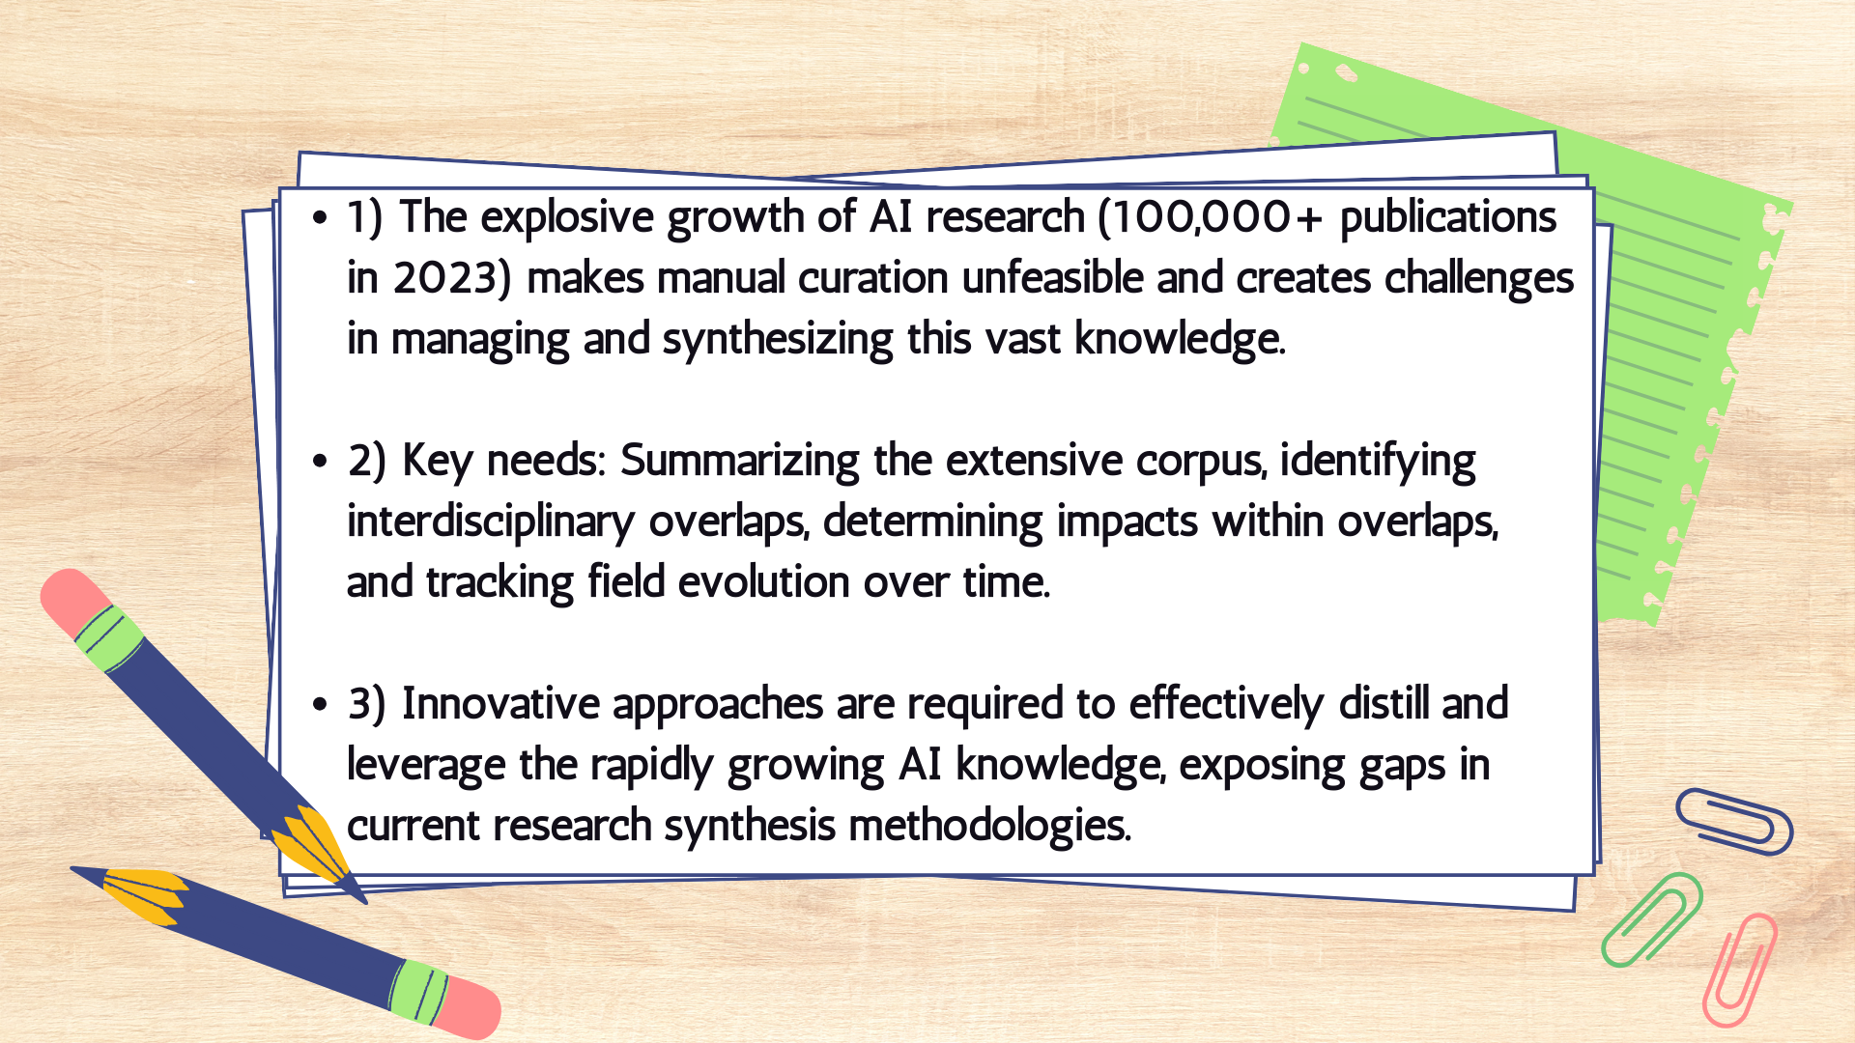
Research Gap Analysis

Slide 6
Project Objectives
- Leverage topic modeling to summarize AI advancements and their impact across various fields, focusing on transportation.
- Enhance integration and application of AI to tackle critical research challenges.

Slide 7

Literature Review

Slide 8
Key Questions to Consider
Resources & Databases:
- Utilized platforms like Scopus, Web of Science, Dimensions, Google Scholar, and CiteSeerX for the literature review.
Available Information:
- Access to publication titles, topics (authors' keywords), publication years, authors, and citation metrics.
Studying Interconnections
- Analyze keywords and their relationships across publications to gain a comprehensive understanding of the research landscape.

Slide 9
Navigating the Landscape of Modern Research: Tools, Techniques, and Innovations in Literature Review
Literature Review Software
Bibliographic Management Software
Software | Description
VOSviewer | Bibliometric networks visualization
CiteSpace | Visualizing scientific literature patterns (Java)
Gephi | Network analysis and visualization
R Packages | Bibliometrix, Biblioshiny (Py too via NLTK, Pandas, Scikit-Learn)
ContentMine | Extracts facts from academic literature
Rayyan QCRI & Covidence | Systematic literature review screening
Software | Description
EndNote, Mendeley, Zotero | Reference managers, includes PDF annotation and more, most commonly used
JabRef & BibDesk | Specialized for managing BibTeX records
Docear | Designed for academic literature and mapping/organization
Qiqqa | Designed around PDF management and annotation/review tools
Citavi | Includes task planning with bibliographic management

Slide 10
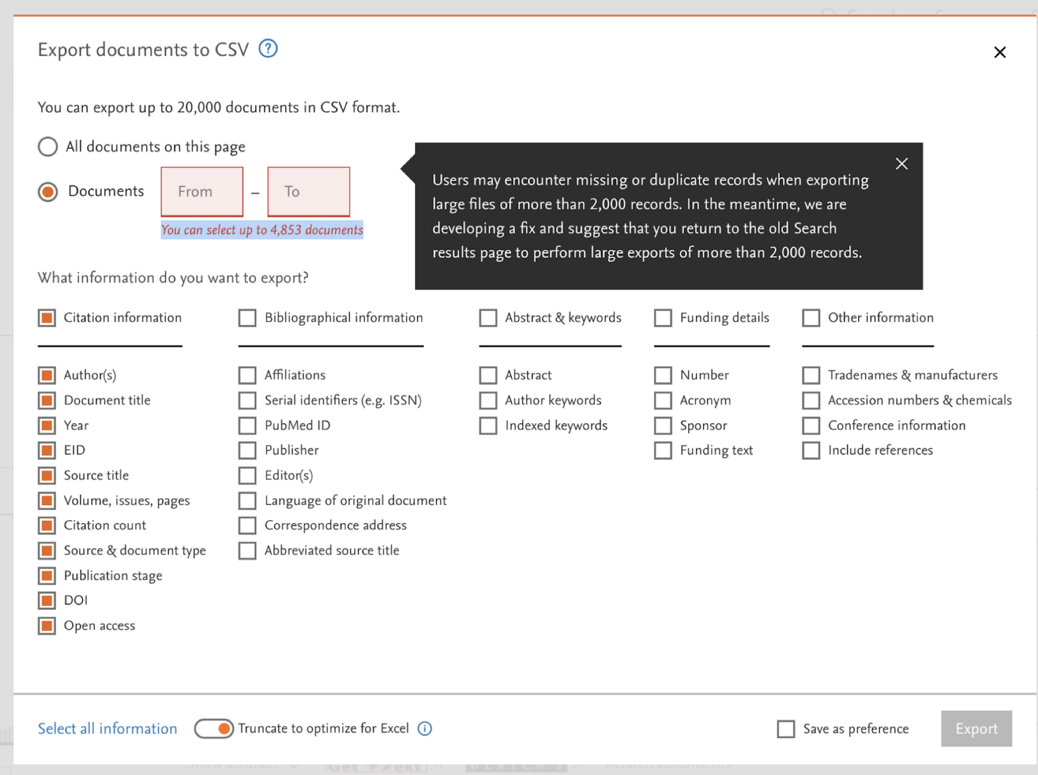
Scopus
API Support (Elsevier Dev Portal)
Custom Record Extraction: Users can extract detailed information including:
  Author
  Article Title
  Source Title
  Document Type
  Abstract
  Publication Year
  Unique WOS ID
  DOI Link
  Citations

Slide 11
Visualization Tools
Tools for Streamlining Literature Reviews:
- Paper Digest: Facilitates rapid literature review by summarizing research papers.
- Elicit: A research assistant that helps in identifying relevant studies quickly.
Tools for Visualizing Literature Connections:
- Litmaps: Offers a visual exploration of the connections between academic papers.
- Connected Papers: Creates a graph to visually map out the relationships between research papers.
- Research Rabbit: Enables the discovery of related research through visual exploration and mapping.

Slide 12
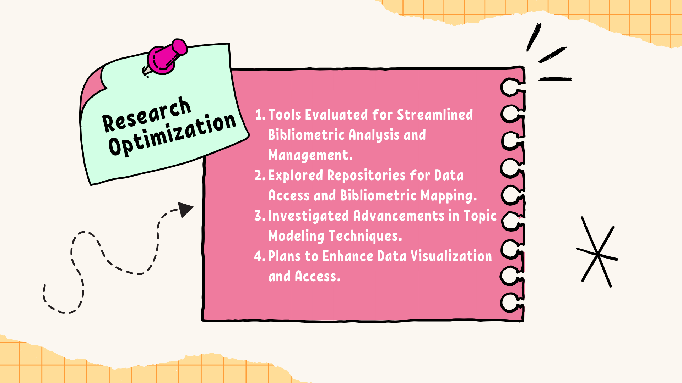

Slide 13
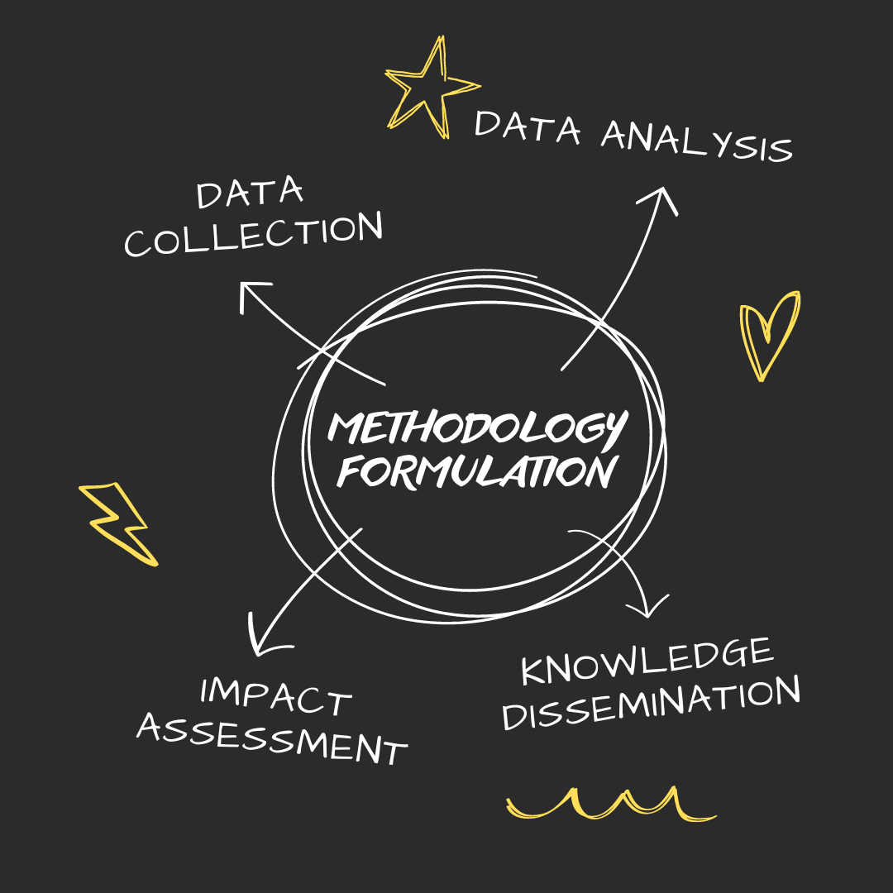
Frameworks & Models:
- Select evaluation frameworks for AI readiness and effectiveness.
Data Collection & Structuring:
- Developed automated techniques for data gathering and structuring.
Advanced Analyses:
- Applied statistical and machine learning analyses.
Impact Assessment:
- Evaluate research impact through citation analysis and alt metrics.
Knowledge Dissemination:
- Share findings via dynamic visualizations and publications.

Slide 14
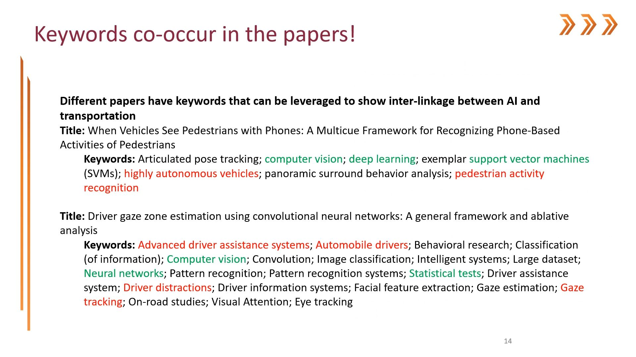

Slide 15
Methodology Formulation
Data Extraction & Analysis:
- Advanced data mining and API integration
- Key technologies included Python Requests, Scopus API, and IEEE Xplore API
- Web scraping and NLP-based data cleaning techniques for data extraction
Natural Language Processing Techniques:
- Employed SpaCy, text preprocessing, word embeddings, and vectorization methods
- Topic coherence and syntax parsing techniques for identification of relevant themes and trends
- Development of data-driven analysis also included: Django, PHP, JavaScript, and DHTMLX Gantt
Interactive Data Visualization:
- Included word clouds, chord diagrams, heat maps & Sankey diagrams
- Interactive & dynamic visualizations utilizing D3-JS, JavaScript & React (Frameworks)
- Enable informed, data-driven decisions and provide actionable insights

Slide 16
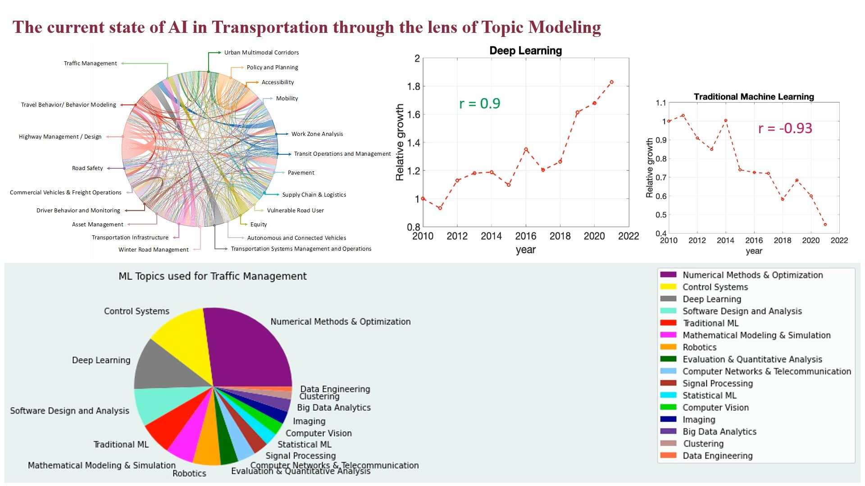

Slide 17
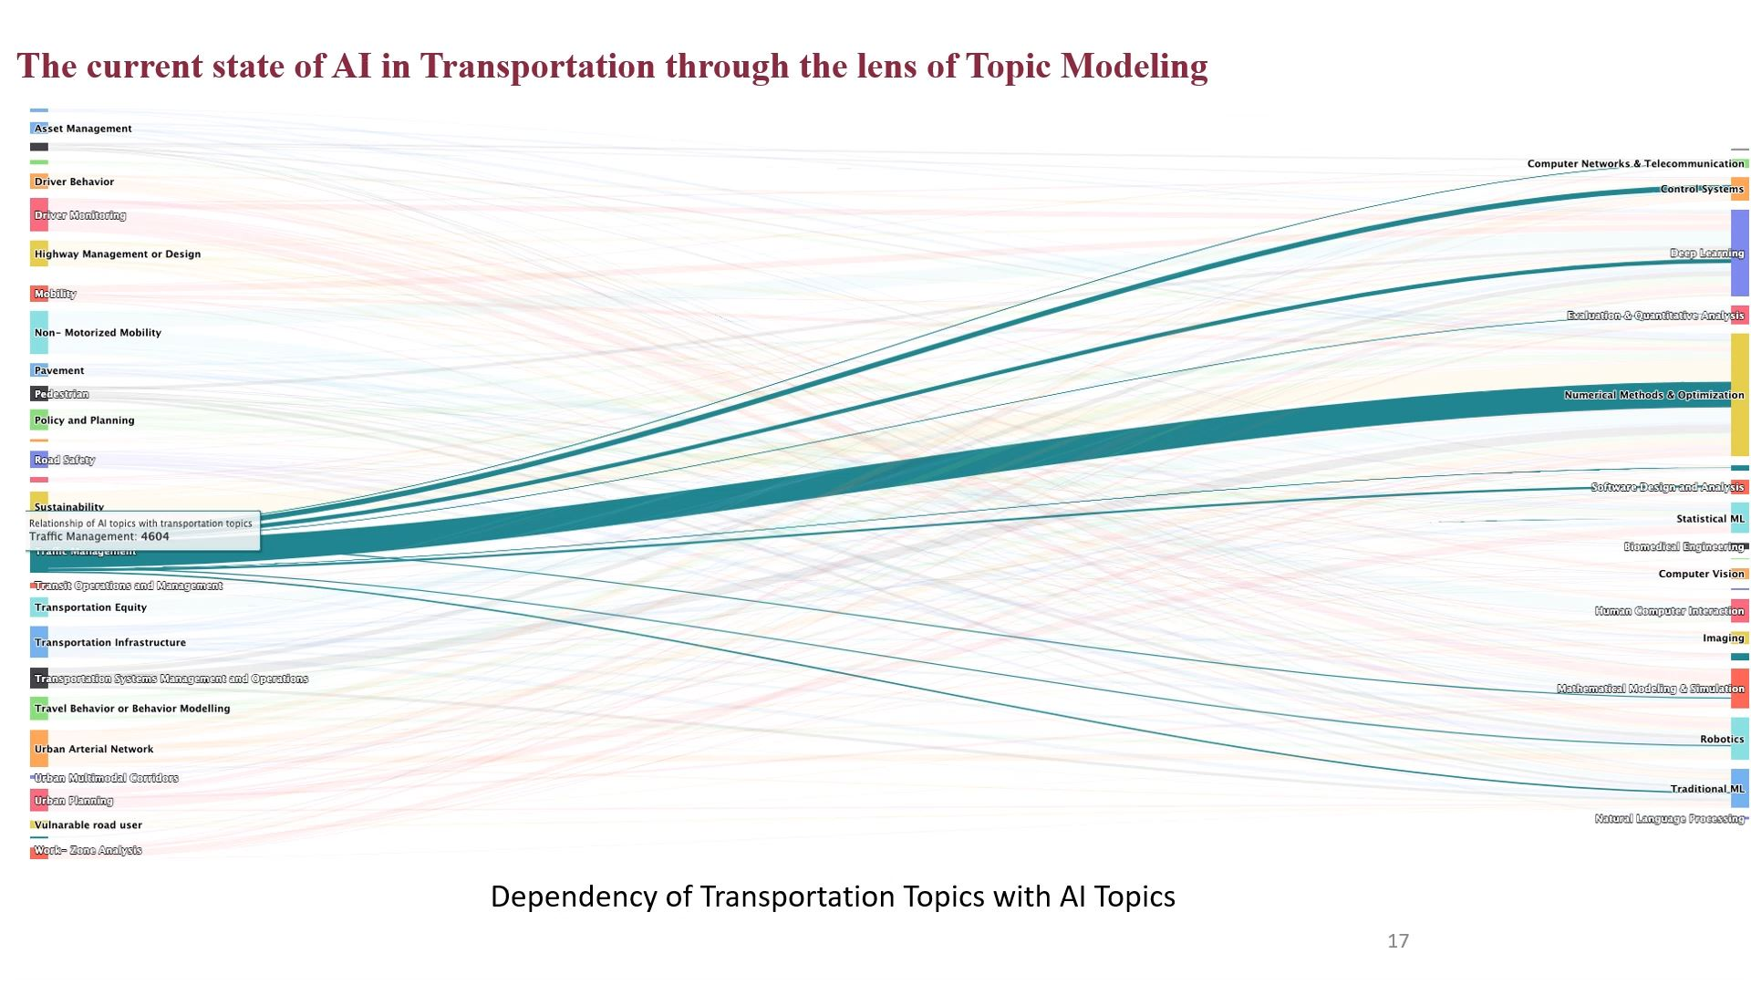

Slide 18
Suren Thapa & Abhijit Sarkar, PhD - VTTI
Sarah Over, PhD - University Libraries
Chaitanya Kanakamedala - COE

